Slide 1
Tutorial 4 Pricing

Slide 2
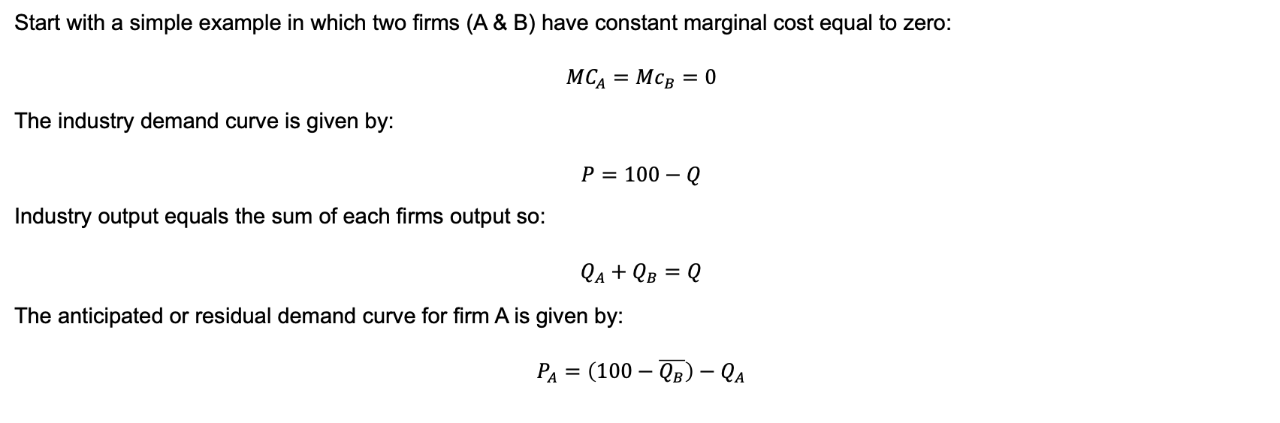
Oligopoly – the Cournot Model
Start with a simple example in which two firms (A & B) have constant marginal cost equal to zero:
$${MC}_{A}={Mc}_{B}=0$$
The industry demand curve is given by: $$P=100−Q$$
Industry output equals the sum of each firms output so:
$$Q_{A}+Q_{B}=Q$$
The anticipated or residual demand curve for firm A is given by:
$$P_{A}=\left(100−\overline{Q_{B}}\right)−Q_{A}$$

Slide 3

Oligopoly – the Cournot Model
$$P=100−Q$$
$$Q_{A}+Q_{B}=Q$$
$$P=100−\left(Q_{A}+Q_{B}\right)$$
$$P=100−Q_{A}−Q_{B}$$
$$P_{A}=\left(100−\overline{Q_{B}}\right)−Q_{A}$$

Slide 4
the Residual demand curve
P
100
100-Q_{B}
Residual demand curve
0
0
100-Q_{B}
100
Q
Marginal revenue

Slide 5
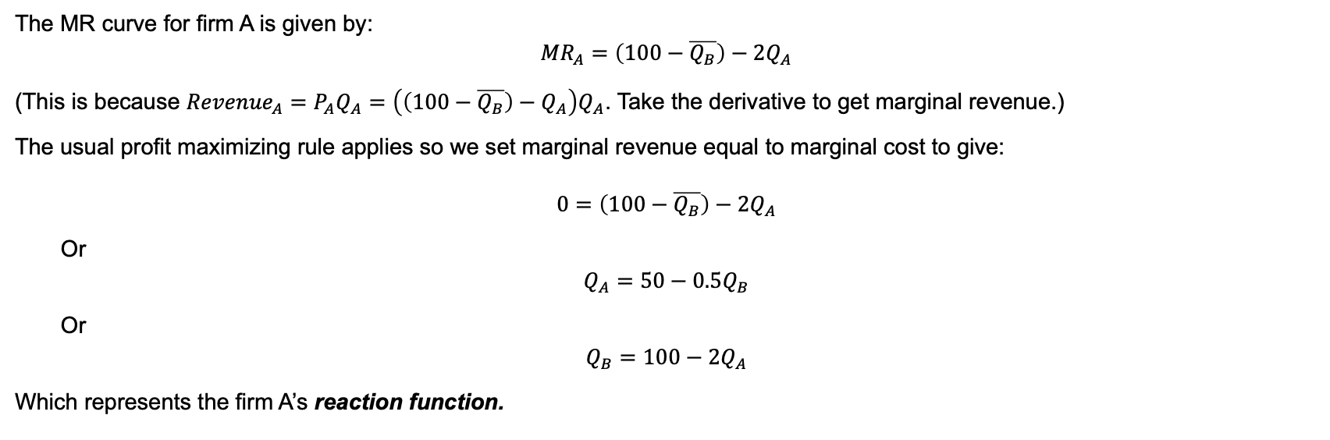
Oligopoly – the Cournot Model
The MR curve for firm A is given by:
$${MR}_{A}=\left(100−\overline{Q_{B}}\right)−{2Q}_{A}$$
(This is because ${Revenue}_{A}=P_{A}Q_{A}=$ $\left(\left(100−\overline{Q_{B}}\right)−Q_{A}\right)Q_{A}$. Take the derivative to get marginal revenue.)
The usual profit maximizing rule applies so we set marginal revenue equal to marginal cost to give:
$$0=\left(100−\overline{Q_{B}}\right)−{2Q}_{A}$$
Or
$$Q_{A}=50−0.5Q_{B}$$
Or
$$Q_{B}=100−2Q_{A}$$
Which represents the firm A’s reaction function.

Slide 6
Question 1
Read the following articles that are available on Canvas:
Daripa and Kapur (2001), ‘Pricing on the internet’, Oxford Review of Economic Policy 17(2), pp. 202-16.
Nikas, J. (2015), “Now prices can change from minute to minute” from Wall Street Journal.
Now consider the following questions:
The article by Daripa and Kapur (2001) is somewhat dated, but nonetheless it is instructive as to how the internet might change ‘pricing’ behaviour. What are some of the key behaviours they identify? Have they come to fruition? Why or why not?
What does the article by Nikas highlight has happened to pricing behavior of firms in light of the possibilities that are available from the internet?

Slide 7
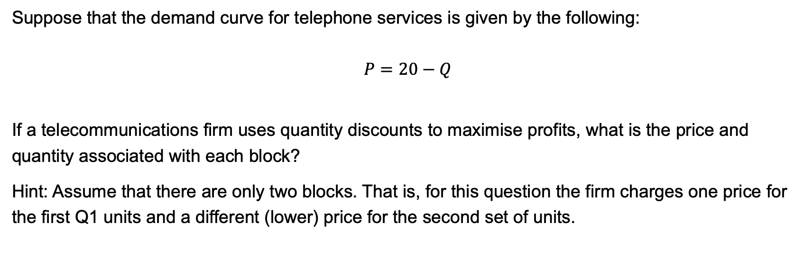
Question 2
Suppose that the demand curve for telephone services is given by the following:
$$P=20−Q$$
If a telecommunications firm uses quantity discounts to maximise profits, what is the price and quantity associated with each block?
Hint: Assume that there are only two blocks. That is, for this question the firm charges one price for the first Q1 units and a different (lower) price for the second set of units.

Slide 8
Question 2

Slide 9
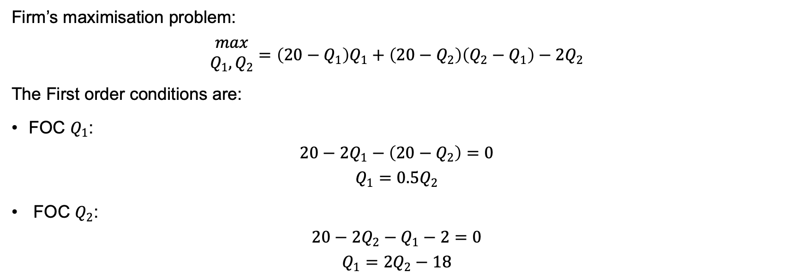
Question 2
Firm’s maximisation problem:
$$\begin{matrix}max \\ Q_{1},Q_{2}\end{matrix}=\left(20−Q_{1}\right)Q_{1}+\left(20−Q_{2}\right)\left(Q_{2}−Q_{1}\right)−2Q_{2}$$
The First order conditions are:
FOC $Q_{1}$:
$$20−2Q_{1}−\left(20−Q_{2}\right)=0$$
$$Q_{1}=0.5Q_{2}$$
FOC $Q_{2}$:
$$20−2Q_{2}−Q_{1}−2=0$$
$$Q_{1}=2Q_{2}−18$$

Slide 10
Question 2
So, solving for Q₁ and Q₂ we get Q₁ = 6 and Q₂ = 12 with corresponding prices P₁ = 14 and P₂ = 8.

Slide 11
Question 3
Assume that a travel agency is selling holidays to Europe. Those holidays consist of an airfare and or a hotel. Assume there are three customer types with valuations given by the following:
Finally, assume that the marginal cost of the airfare and the hotel is $300.
What are the optimal prices of the air fare and the hotel if there is no bundling?
If the airfare and hotel are sold as a bundle, what is the optimal price of the bundle?
If optional bundling is used, what are the optimal prices of the airfare, the hotel and the bundle?
Customer | Airfare | Hotel
1 | 100 | 800
2 | 500 | 500
3 | 800 | 100

Slide 12
Question 3
No bundling
P_{A} = P_{H} = 100
Here the firms sells both the flight and hotel to everyone but makes a loss because the MC of each is 300
P_{A} = P_{H} = 500
Here the firms sells two hotels and two flights (each customer buys as long as their valuation is greater than or equal to the price). Profits are $800 = 4x$500-4x$300.
P_{A} = P_{H} = 800
Here the firms sells one hotel and one flight (each customer buys as long as their valuation is greater than or equal to the price). Profits are $1000

Slide 13
Question 3
Pure bundling
P_{B} =900
Here the firms sell the bundle to each customer. Revenues are $2700 and costs are $1800 for a profit of $900
P_{B} =1000
Here the firms sell only one bundle to customer 2. Revenues are $1000 and costs are $600 for a profit of $400.

Slide 14
Question 3
Mixed or optional bundling
Note that here that customer 1 has a valuation for the air ticket that is less than its MC, similarly customer 3 has a valuation of the hotel room that is less than its MC.
What to do? Adding an extra through bundling won’t increase profit for these customers because the additional costs for customers 1 and 3 doesn’t exceed the extra surplus that could be extracted. Hence, you don’t really want these customers to take the bundle. Instead, you want to sell them the individual items at the highest possible price while still encouraging the second customer to take the bundle.
P_{A} = 800, P_{H} = 800, P_{H} = 1000
In this case the firm will sell the hotel to customer 1, the ticket to customer 3 and the bundle to customer 2. Total sales are $2600, costs are $1200 and profit is $1400. This strategy maximizes profit.

Slide 15
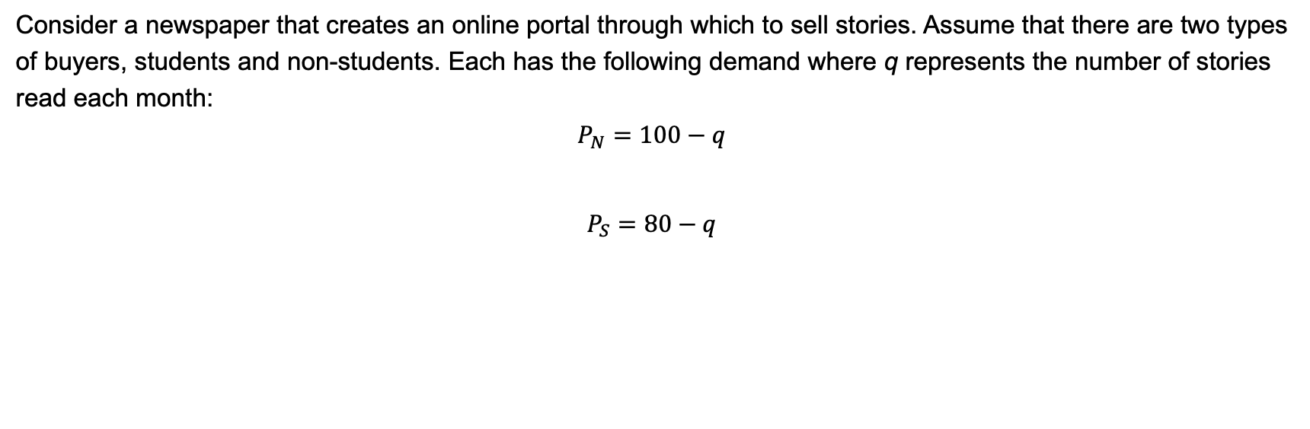
Question 4
Consider a newspaper that creates an online portal through which to sell stories. Assume that there are two types of buyers, students and non-students. Each has the following demand where q represents the number of stories read each month:
$$P_{N}=100−q$$
$$P_{S}=80−q$$

Slide 16
Question 4
Further, assume that the marginal cost of producing stories is zero.
If the newspaper can identify different types of buyers, what price will they charge students and non-students for an all or nothing deal? That is, one in which a package of a maximum number of stories is offered at a fixed price per month?
What is the most that students will pay for reading 80 articles per month? How much will non-students pay to read up to 80 articles per month?
What is the maximum price that the newspaper could charge for the 100 articles per month if it wanted the non-students to prefer this to the 80 article per month option?
Suppose that only 60 articles per month are included in the student subscription, what is the maximum it could charge for this and still get students to pay? How much surplus would a non-student get from the student package?
How much could the newspaper charge for the 100-article package and still ensure that non-students buy it rather than the student package?
Which set of offers (the 60 and 100 article subscriptions, or the 80 and 100 article subscriptions) offers the highest profits?

Slide 17
Question 4

Slide 18
Question 4(a)

Slide 19
Question 4(B)

Slide 20
Question 4(C)

Slide 21
Question 4(D)

Slide 22
Question 4(E)

Slide 23
Question 4(F)
Which set of offers (the 60 and 100 article subscriptions, or the 80 and 100 article subscriptions) offers the highest profits?
An 80 and 100 article menu gives profit of $66. That is, they can charge a price of $32 for the 80-article subscription and $34 for the 100-article subscription. The students buy the 80-article subscription and the non-students buy the 100 article subscription.
A 60 and 100 article menu gives profit of $68. That is, they can charge a price of $30 for the 60-article subscription and $38 for the 100-article subscription.

Slide 24
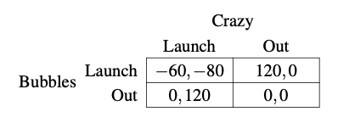
2019 Mid-semester Question 1
Bubbles and Crazy Juices are two rival bottled drink manufacturers. Both are considering launching a new carbonated guava juice drink on the Sydney University campus. There is sufficient demand to sustain only one carbonated guava drink. Bubbles and Crazy must simultaneously decide whether to launch or stay out of the market. The matrix below summarises payoffs.

Slide 25
2019 Mid-semester Question 1
(a) Identify all Nash equilibria to this game.

Slide 26
2019 Mid-semester Question 1
(a) Identify all Nash equilibria to this game.

Slide 27
2019 Mid-semester Question 1
(a) Identify all Nash equilibria to this game.

Slide 28
2019 Mid-semester Question 1
(a) Identify all Nash equilibria to this game.

Slide 29
2019 Mid-semester Question 1
(a) Identify all Nash equilibria to this game.

Slide 30
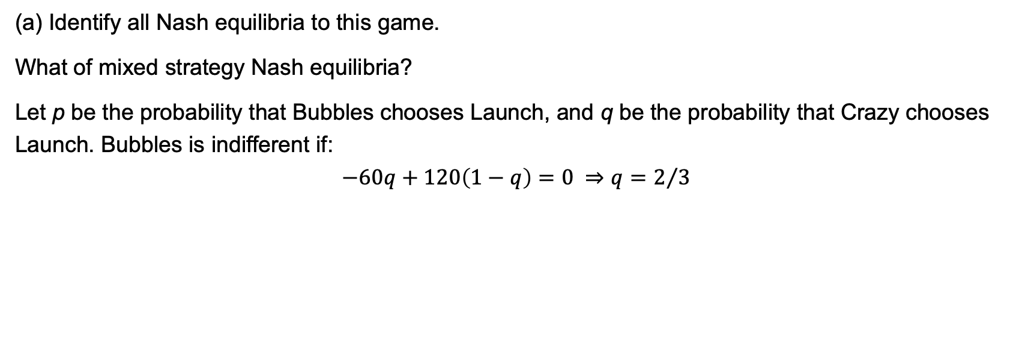
2019 Mid-semester Question 1
(a) Identify all Nash equilibria to this game.
What of mixed strategy Nash equilibria?
Let p be the probability that Bubbles chooses Launch, and q be the probability that Crazy chooses Launch. Bubbles is indifferent if:
$$−60q+120\left(1−q\right)=0 ⇒q=2/3$$

Slide 31
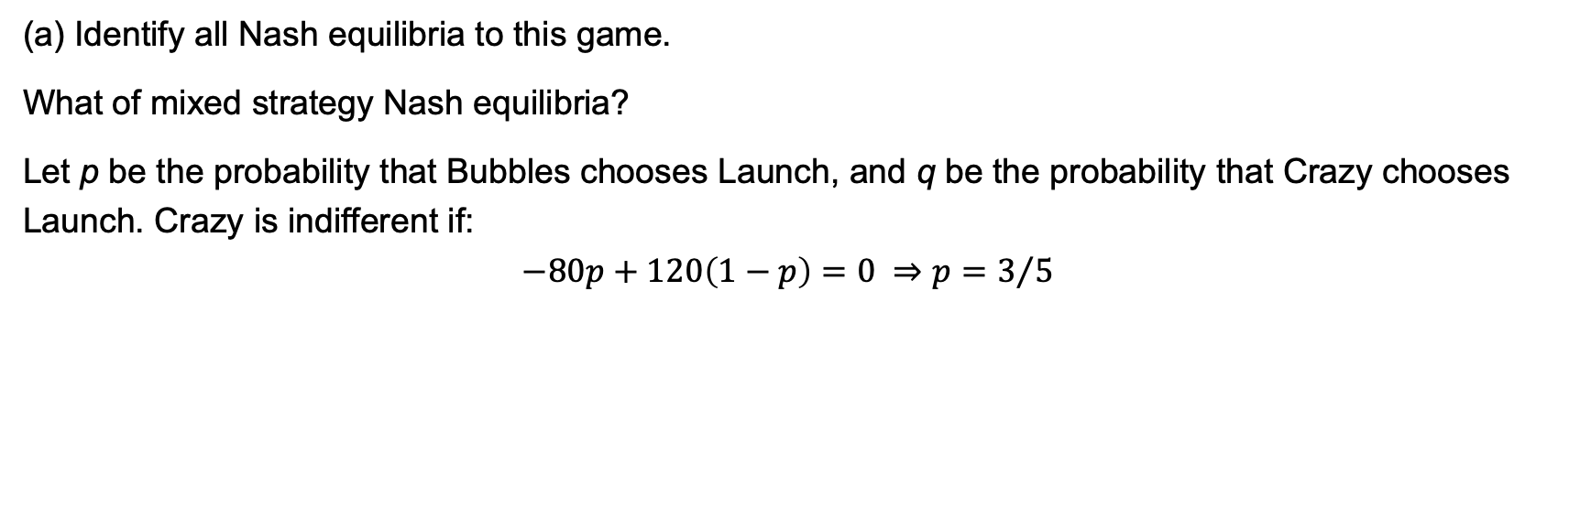
2019 Mid-semester Question 1
(a) Identify all Nash equilibria to this game.
What of mixed strategy Nash equilibria?
Let p be the probability that Bubbles chooses Launch, and q be the probability that Crazy chooses Launch. Crazy is indifferent if:
$$−80p+120\left(1−p\right)=0 ⇒p=3/5$$

Slide 32
2019 Mid-semester Question 1
(b) The CEO at Crazy Juices thinks it would be a good idea to wait to gather information before deciding whether to launch. Consider a sequential moves game in which Bubbles makes their launch decision first. Crazy observes this decision and then chooses whether to launch. Illustrate this game with a diagram and solve for the subgame perfect Nash equilibrium to the game. Would you advise the CEO at Crazy to wait? Explain.

Slide 33
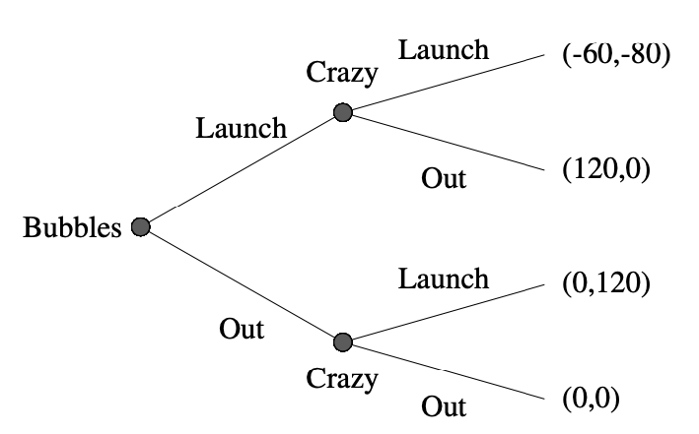
2019 Mid-semester Question 1

Slide 34
2019 Mid-semester Question 1

Slide 35
2019 Mid-semester Question 1

Slide 36
2019 Mid-semester Question 1

